Slide 1
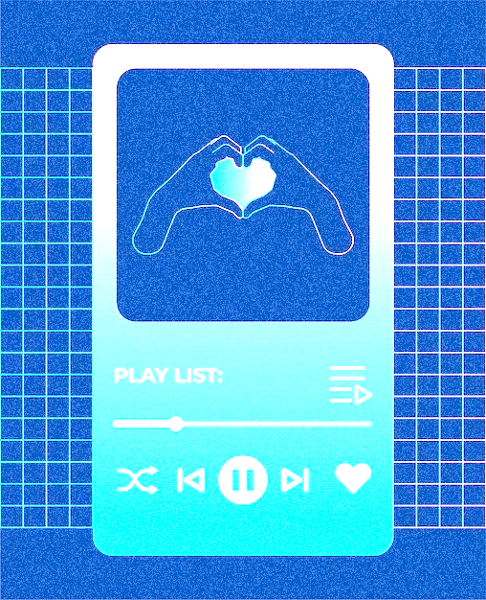
Mood music
Emotion-based Music Player

Slide 2


Project team
Sairaj jawalikar
Sahil
parab
| Developer |
| Creative Head |
Vikas
vighne
Om
shelke
| Brainstormer |
| Ideator |

Slide 3

introduction
Emotion-based music player is an intelligent system that detects a user's emotional state - typically through facial expressions, voice tone, or physiological signals and plays music that matches or alters their mood.
By integrating technologies like AI, machine learning, and emotion recognition, it aims to enhance user experience, offering personalized and mood-appropriate music playback automatically.

Slide 4



Problem statement
Traditional music players require manual input to select songs, which may not always align with a user's emotional state. This can limit user satisfaction and emotional engagement.
There is a need for a smart system that can automatically detect a user's emotions and play music accordingly to enhance mood and provide a personalized listening experience.
Such a system can bridge the gap between emotional well-being and technology-driven entertainment.

Slide 5
Architecture
Emotion
Detection
Music Recommendation
Playback & Adjustment
Capture emotional data (e.g., facial)
Suggest music based on emotion.
Adjust music in real-time based on mood
Interpretation
Feedback Loop
Analyze and classify emotional state
Refine recommendations with user feedback

Slide 6
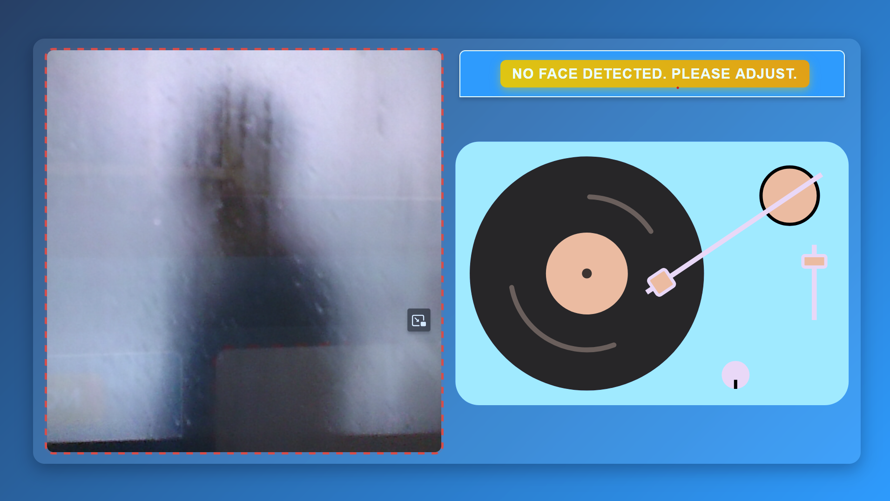

Let’s take a closer look at how it works in real-time
Try it yourself at: https://getsomesleepbro.github.io/MoodMusic/

Slide 7




applications
Real-World usecases
Smart Cars with Adaptive Mood-Based Environments
Integrated to adjust not just music, but ambient lighting and seat settings based on the driver’s mood—reducing stress and improving safety on long drives or in traffic.
Mental Health & Wellness Apps
Helps users manage stress, anxiety, or low mood by playing calming or uplifting music based on their emotional state.
Healthcare & Therapeutic Settings
Emotion-based music players can be used in healthcare settings, like hospitals or nursing homes, to improve patient mood, reduce anxiety, or aid in therapy.

Slide 8
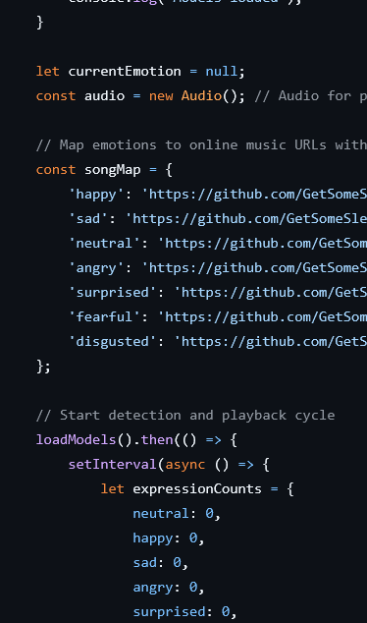




Research
Emotion-Aware Music Recommendation System: Enhancing User Experience Through Real-Time Emotional Context​
→ https://arxiv.org/abs/2311.10796
An Emotion-Based Personalized Music Recommendation Framework for Emotion Improvement
→ https://www.sciencedirect.com/science/article/abs/pii/S0306457322003570
LyQ - An Emotion-Aware Music Player
→ https://aaai.org/papers/ws06-04-017-lyq-an-emotion-aware-music-player
Emotion-Based Music Player Using CNN
→ https://www.ijraset.com/research-paper/emotion-based-music-player-using-cnn

Slide 9


Conclusion
Emotion-based music players use AI and emotion recognition to detect a user’s mood and play suitable music.
This creates a more personalized and emotionally engaging experience, improving both user satisfaction and overall well-being.

Slide 10


Thank you
Mood Music

